Slide 1
Arhitecturi Paralele Abordări probleme paralele
Prof. Florin Pop
As. Drd. Ing. Cristian Chilipirea
cristian.chilipirea@cs.pub.ro
Elemente preluate din cursul Prof. Ciprian Dobre

Slide 3
Merge algorithm
2
3
4
5
7
1
2
4
4
6
Take two sorted lists
merge them
Into one sorted list
1
2
2
3
4
4
4
5
6
7

Slide 4
Merge algorithm
2
3
4
5
7
1
2
4
4
6
Solution:
Always extract the smallest element from the lists
(guaranteed to be first in one of them)
O(n) complexity
1
2
2
3
4
4
4
5
6
7

Slide 5
Merge algorithm
2
3
4
5
7
1
2
4
4
6

Slide 6
Merge algorithm
2
3
4
5
7
2
4
4
6
1

Slide 7
Merge algorithm
3
4
5
7
2
4
4
6
1
2

Slide 8
Merge algorithm
3
4
5
7
4
4
6
1
2
2

Slide 9
Merge algorithm
4
5
7
4
4
6
1
2
2
3

Slide 10
Merge algorithm
5
7
4
4
6
1
2
2
3
4

Slide 11
Merge algorithm
5
7
4
6
1
2
2
3
4
4

Slide 12
Merge algorithm
5
7
6
1
2
2
3
4
4
4

Slide 13
Merge algorithm
7
6
1
2
2
3
4
4
4
5

Slide 14
Merge algorithm
7
1
2
2
3
4
4
4
5
6

Slide 15
Merge algorithm
1
2
2
3
4
4
4
5
6
7

Slide 16
Merge algorithm
1
2
2
3
4
4
4
5
6
7
For next slides this sign means merge
2
3
4
5
7
1
2
4
4
6

Slide 17

Merge sort
1
2
2
3
4
4
5
7
Break the initial list in lists of one element
Lists of one element are sorted
Apply merge recursively
$$\log_{2}n$$
2
3
4
5
7
1
2
4

Slide 18
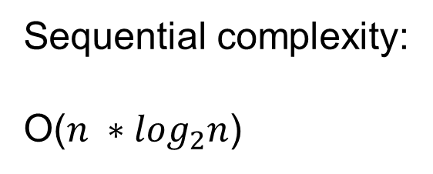
Merge sort
1
2
2
3
4
4
5
7
Sequential complexity:
O(${n ∗log}_{2}n$)
………………………….
…..
…..
…..
2
3
4
5
7
1
2
4

Slide 19
Merge sort
2
3
4
5
7
1
2
4

Slide 20
Merge sort
2
3
4
5
7
1
2
4

Slide 21
Merge sort
2
3
4
5
7
1
2
4

Slide 22
Merge sort
2
3
4
5
1
7
2
4

Slide 23
Merge sort
2
3
4
5
1
7
2
4

Slide 24
Merge sort
2
3
4
5
1
7
2
4

Slide 25
Merge sort
2
3
4
5
1
2
4
7

Slide 26
Merge sort
1
2
2
3
4
4
5
7

Slide 27
Parallel merge sort
1
2
2
3
4
4
5
7
Can be executed
in parallel
Can be executed
in parallel
2
3
4
5
7
1
2
4

Slide 28
Parallel merge sort
1
2
2
3
4
4
5
7
Result of
depends on result of
Can NOT be executed
in parallel
2
3
4
5
7
1
2
4

Slide 29
Parallel merge sort
1
2
2
3
4
4
5
7
Each level of the tree needs to wait for the operations on the previous level to finish
Solution:
Barrier between
each level of the tree
2
3
4
5
7
1
2
4

Slide 30

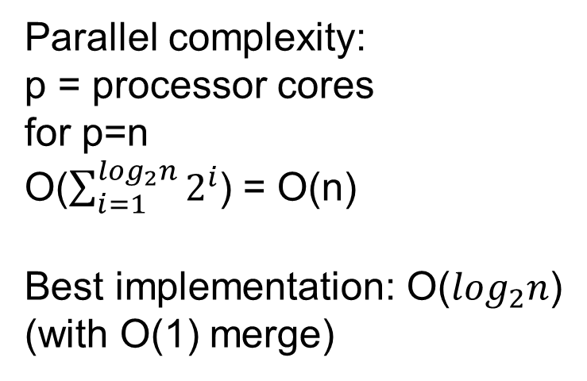
Parallel merge sort
Parallel complexity:
p = processor cores
for p=n
O($\sum_{i=1}^{\log_{2}n}{2^{i}}$) = O(n)
Best implementation: O($\log_{2}n$)
(with O(1) merge)
http://goo.gl/okU3fM
2
3
4
5
7
1
2
4

Slide 31
Parallel merge sort
2
3
4
5
7
1
2
4

Slide 32
Parallel merge sort
2
3
4
5
1
7
2
4

Slide 33
Parallel merge sort
2
3
4
5
1
2
4
7

Slide 34
Parallel merge sort
1
2
2
3
4
4
5
7

Slide 36
Executor Service
ExecutorService tpe =
Executors.newFixedThreadPool(4);
Main thread

Slide 37
Executor Service
public class MyRunnable implements Runnable {
int a;
ExecutorService tpe;
public MyRunnable(ExecutorService tpe, int a) {
this.a = a;
this.tpe = tpe;
}
@Override
public void run() {
if (a > 10) {
tpe.shutdown();
return;
}
System.out.println(a);
tpe.submit(new MyRunnable(tpe, a + 3));
}
}

Slide 38
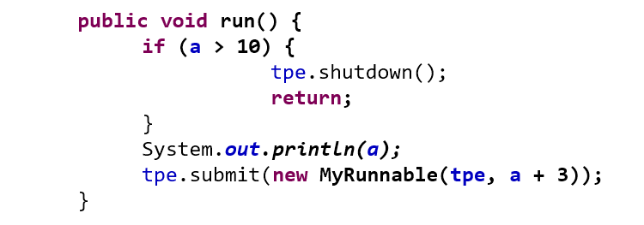
Executor Service
tpe.submit(new MyRunnable(tpe, 0));
tpe.submit(new MyRunnable(tpe, 1));
tpe.submit(new MyRunnable(tpe, 2));
……

Slide 39
Executor Service

Slide 40
Executor Service
Tasks can generate more tasks
tpe.submit(new MyRunnable(tpe, a + 3));

Slide 41
Executor Service

Slide 42
Executor Service

Slide 43
Executor Service

Slide 44
Executor Service

Slide 45
Executor Service
When do you stop the threads?
Depends on the problem.
Sometimes one solution is enough.
But some problems might not have solutsions.
tpe.shutdown();

Slide 47
N Queens Problem
Q
Q
Q
Q

Slide 48
N Queens Problem
No more then one queen per line
Q
Q
Q
Q

Slide 49
N Queens Problem
No more then one queen per column
Q
Q
Q
Q

Slide 50
N Queens Problem
No more then one queen per diagonals
Q
Q
Q
Q

Slide 51
N Queens Problem
0
1
2
3
0
1
2
3
0
Q
1
3
0
2
1
Q
2
Q
These two mean the same thing
3
Q

Slide 52
N Queens Problem - Solution
0
1
2
3
0
1
2
3
0
Q
0
1
2
3

Slide 53
N Queens Problem - Solution
0
1
2
3
0
1
2
3
0
Q
Q
0
0
1
2
Line conflict
3

Slide 54
N Queens Problem - Solution
0
1
2
3
0
1
2
3
0
Q
0
1
1
Q
2
Diagonal conflict
3

Slide 55
N Queens Problem - Solution
0
1
2
3
0
1
2
3
0
Q
0
2
1
2
Q
OK.
And so on…
3

Slide 56
N Queens Problem – Parallel Solution
0
1
2
3
0
1
2
3

Slide 57
N Queens Problem – Parallel Solution
0
1
2
3
0
1
2
3
0
0
X
1
0
X
0
1
X
1
1
X
0
2
1
2
X
0
3
1
3
0
1
2
3
And so on…
0
1
2
3
2
0
3
0
2
1
X
3
1
2
2
X
3
2
X
2
3
X
3
3
X

Slide 58
Abordarea log sau arbore

Slide 59
Reduce
Apply the same operation between all the elements of a vector.
Can be executed in log(n) time using a tree form.
The operation can take many forms (+, *, min, max, and, etc.)

Slide 60
Reduce - sum
9
4
2
7
3
5
6
1
2
5
6
1
3
9
0
1
13
9
8
7
7
7
12
1
Can all be executed in parallel

Slide 61
Reduce - sum
13
9
8
7
7
7
12
1
22
15
14
13
Can all be executed in parallel

Slide 62
Reduce - sum
22
15
14
13
37
27
Can all be executed in parallel

Slide 63
Reduce - sum
37
27
64

Slide 64
Reduce - sum
9
4
2
7
3
5
6
1
2
5
6
1
3
9
0
1
13
9
8
7
7
7
12
1
22
15
14
13
37
27
64

Slide 66
Scan
Apply the same operation between all the elements of a vector.
Obtains all partial results.
Can be executed in log(n) time using a special tree form.
The operation can take many forms (+, *, min, max, and, etc.)

Slide 67
Scan - sum
9
4
2
7
3
5
6
1
+
+
+
+
+
+
+
9
13
15
22
25
30
36
37

Slide 68
Scan - sum
9
4
2
7
3
5
6
1
9
13
6
9
10
8
11
7
Can all be executed in parallel

Slide 69
Scan - sum
9
13
6
9
10
8
11
7
9
13
15
22
16
17
21
15
Can all be executed in parallel

Slide 70
Scan - sum
9
13
15
22
16
17
21
15
9
13
15
22
25
30
36
37
Can all be executed in parallel

Slide 71
Scan – How it works?
9
4
2
7
3
5
6
1
9
13
6
9
10
8
11
7
9
13
15
22
16
17
21
15
9
13
15
22
25
30
36
37

Slide 72
Scan – How it works?
9
4
2
7
3
5
6
1
9
13
6
9
10
8
11
7
9
13
15
22
16
17
21
15
9
13
15
22
25
30
36
37

Slide 73
Scan – How it works?
9
4
2
7
3
5
6
1
9
13
6
9
10
8
11
7
9
13
15
22
16
17
21
15
9
13
15
22
25
30
36
37

Slide 74
Scan – How it works?
9
4
2
7
3
5
6
1
9
13
6
9
10
8
11
7
9
13
15
22
16
17
21
15
9
13
15
22
25
30
36
37

Slide 75
Scan – How it works?
9
4
2
7
3
5
6
1
9
13
6
9
10
8
11
7
9
13
15
22
16
17
21
15
9
13
15
22
25
30
36
37

Slide 76
Scan – How it works?
9
4
2
7
3
5
6
1
9
13
6
9
10
8
11
7
9
13
15
22
16
17
21
15
9
13
15
22
25
30
36
37

Slide 77
Scan – How it works?
9
4
2
7
3
5
6
1
9
13
6
9
10
8
11
7
9
13
15
22
16
17
21
15
9
13
15
22
25
30
36
37

Slide 78
Scan – How it works?
9
4
2
7
3
5
6
1
9
13
6
9
10
8
11
7
9
13
15
22
16
17
21
15
9
13
15
22
25
30
36
37

Slide 79
Scan – How it works?
9
4
2
7
3
5
6
1
9
13
6
9
10
8
11
7
9
13
15
22
16
17
21
15
9
13
15
22
25
30
36
37

Slide 80
Scan – How it works?
9
4
2
7
3
5
6
1
9
13
6
9
10
8
11
7
9
13
15
22
16
17
21
15
9
13
15
22
25
30
36
37

Slide 81
Scan – How it works?
9
4
2
7
3
5
6
1
9
13
6
9
10
8
11
7
9
13
15
22
16
17
21
15
9
13
15
22
25
30
36
37

Slide 82
Scan – How it works?
9
4
2
7
3
5
6
1
9
13
6
9
10
8
11
7
9
13
15
22
16
17
21
15
9
13
15
22
25
30
36
37

Slide 83
Scan – How it works?
9
4
2
7
3
5
6
1
9
13
6
9
10
8
11
7
9
13
15
22
16
17
21
15
9
13
15
22
25
30
36
37

Slide 84
Scan – How it works?
9
4
2
7
3
5
6
1
9
13
6
9
10
8
11
7
9
13
15
22
16
17
21
15
9
13
15
22
25
30
36
37

Slide 85
Scan – How it works?
9
4
2
7
3
5
6
1
9
13
6
9
10
8
11
7
9
13
15
22
16
17
21
15
9
13
15
22
25
30
36
37

Slide 86
Scan – How it works?
9
4
2
7
3
5
6
1
9
13
6
9
10
8
11
7
9
13
15
22
16
17
21
15
9
13
15
22
25
30
36
37

Slide 88
Value Broadcast
Start
0
1
2
3
4
5
6
7
8
9
10
11
12
13
14
15
...
7
...

Slide 89
Value Broadcast
End
0
1
2
3
4
5
6
7
8
9
10
11
12
13
14
15
...
7
7
7
7
7
7
7
7
7
7
7
7
7
7
7
7
...

Slide 90
Inefficient Value Broadcast
O(n) time
0
1
2
3
4
5
6
7
8
9
10
11
12
13
14
15
...
7
7
7
7
7
7
7
7
7
7
7
7
7
7
7
7
...
..........

Slide 91
Efficient Value Broadcast
Every element that has the value copies it to its current position + i
i = 1
0
1
2
3
4
5
6
7
8
9
10
11
12
13
14
15
...
7
...

Slide 92
Efficient Value Broadcast
Every element that has the value copies it to its current position + i
i = 2
0
1
2
3
4
5
6
7
8
9
10
11
12
13
14
15
...
7
7
...
These operations can be executed in parallel

Slide 93
Efficient Value Broadcast
Every element that has the value copies it to its current position + i
i = 4
0
1
2
3
4
5
6
7
8
9
10
11
12
13
14
15
...
7
7
7
7
...
These operations can be executed in parallel

Slide 94
Efficient Value Broadcast
Every element that has the value copies it to its current position + i
i = 8
0
1
2
3
4
5
6
7
8
9
10
11
12
13
14
15
...
7
7
7
7
7
7
7
7
...
These operations can be executed in parallel

Slide 95
Efficient Value Broadcast
O(log2(n)) time with p = n/2 processors
0
1
2
3
4
5
6
7
8
9
10
11
12
13
14
15
...
7
7
7
7
7
7
7
7
7
7
7
7
7
7
7
7
...

Slide 96
Efficient Value Broadcast
i = 2
0
1
2
3
4
5
6
7
8
9
10
11
12
13
14
15
...
7
7
...
These operations canNOT be executed in parallel
i = 4
0
1
2
3
4
5
6
7
8
9
10
11
12
13
14
15
...
7
7
7
7
...

Slide 97
Efficient Value Broadcast
i = 2
0
1
2
3
4
5
6
7
8
9
10
11
12
13
14
15
...
7
7
...
i = 4
0
1
2
3
4
5
6
7
8
9
10
11
12
13
14
15
...
7
7
7
7
...

